Slide 1
Parameterized CNN
By Wang Yunong

Slide 2
Idea
Attention Model of Human
Pay More Attention to Area that is important
CNN
More Filters on Area that is important
Less Filters on Area that is Less important
Problem
How to parameterize number of filters

Slide 3
Trade off Model
Differ Contribution of weights
more important areas contribute bigger value
Using mask to depress the contribution of less important area

Slide 4
Implementation
Origin Image
Feature Map
Conv
Feature Map After Mask
Neural Net
multiply
Saliency
Mask
Sal_Calc

Slide 5

Formula
Forward
Input : $x_{i}, s_{i}$
Convlution : $z_{j}=\sum{w_{ij}x_{i}}+b_{j}, y_{j}=f(z_{j})$
SaliencyCalc : $sz_{j}=\sum{θ_{ij}s_{i}}+γ_{j}, sy_{j}=g(sz_{j})$
Multiply : ${fz}_{j}=y_{j}\text{·} sy_{j}=f(z_{j})∙g(sz_{j})$
After : Basic Neural Net

Slide 6





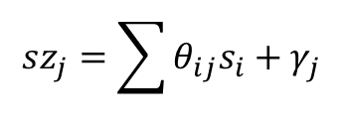
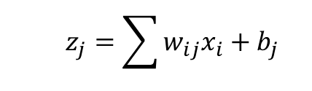
Forward
$$z_{j}=\sum{w_{ij}x_{i}}+b_{j}$$
Origin Image
Feature Map
$$y_{j}=f(z_{j})$$
$$x_{i}$$
Conv
$${fz}_{j}=y_{j}\text{·} sy_{j}$$
Feature Map After Mask
Neural Net
multiply
Saliency
Mask
$$s_{i}$$
Sal_Calc
$$sy_{j}=g(sz_{j})$$
$$sz_{j}=\sum{θ_{ij}s_{i}}+γ_{j}$$

Slide 7

Formula
Backpropagation
Error from next layer : $δ_{l}$
BP Error to Conv Layer: $δ_{l−1}=δ_{l}∙sy∙f^{′}(z_{j})$
BP Error to Sal_Calc Layer: ${sδ}_{l−1}=δ_{l}∙y∙f^{′}({sz}_{j})$
BP after that : Basically the same as usual neural net

Slide 8




Backpropagation
$$δ_{l−1}=δ_{l}∙sy∙f^{′}(z_{j})$$
Origin Image
Feature Map
$$δ_{l}$$
Conv
Feature Map After Mask
Neural Net
multiply
Saliency
Mask
Sal_Calc
$${fz}_{j}=y_{j}\text{·} sy_{j}$$
$${sδ}_{l−1}=δ_{l}∙y∙f^{′}({sz}_{j})$$

Slide 9
Sal_Calc Connection
How to Calc Mask from Saliency
Convolution
Conv Filter Num :
Filter Num 1 : Single Mask For All Feature Maps
Filter Num N : One Mask For Each Feature Map

Slide 10
Experiments
Single Mask
Multi Mask
Name | Net | Accuracy | Epoch
asCaffe | CPCPCPF, 128 filter | 78.88 | @171
sal | 4 saliency | 79.18 | @83
sal_WB | 4 saliency , plus pure white and black | 79.10 | @94
sal_W | 4 saliency , plus pure white | 79.21 | @88
sal_2 | 1 saliency , plus pure white | 78.60 | @185
sal_1 | pure white | 79.05 | @140
asCaffe_256 | CPCPCPF, 256 filter | 78.82 | @68
asCaffe_512 | CPCPCPF, 512 filter | 69.42 | @112
sal_W_256 | as sal_W, 256 filter | 79.91 | @165
sal_multi | 4 saliency , plus pure white, multi mask | 77.10 | @153
sal_multi_sig | mask with sigmoid activation | 79.70 | @61 running

Slide 11
Computation
A full connected net as 3072*1024*512*10
Matrix size : 3072*1024+1024*512+512*10 ~= 3.6M
Calculation : 3072*1024+1024*512+512*10 ~= 3.6M
A CNN net as caffe, 128 filter
Matrix size : 128*5*5*3 + 128*5*5*128 + 128*5*5*128 ~= 0.83M
Calculation : 128*5*5*3*32*32 + 128*5*5*128*16*16 + 128*5*5*128*8*8 ~= 140M
A sal net with single mask, 128 filter
Matrix size : 128*5*5*3 + 1*5*5*4 + 128*5*5*128 + 128*5*5*128 ~= 0.83M
Calculation : 128*5*5*3*32*32 + 5*5*4*32*32 + 128*32*32 + 128*5*5*128*16*16 + 128*5*5*128*8*8 ~= 141M
A sal net with multi mask, 128 filter
Matrix size : 128*5*5*3 + 128*5*5*4 + 128*5*5*128 + 128*5*5*128 ~= 0.84M
Calculation : 128*5*5*3*32*32 + 128*5*5*4*32*32 + 128*32*32 + 128*5*5*128*16*16 + 128*5*5*128*8*8 ~= 154M

Slide 12
Experiments

Slide 13
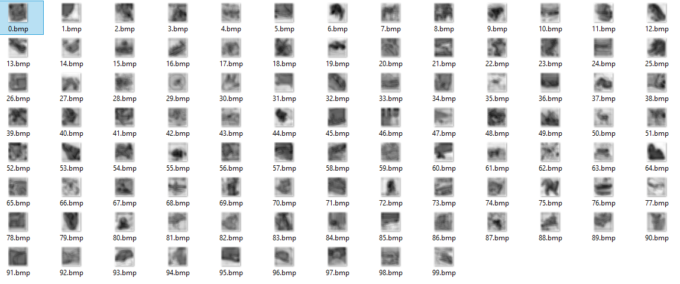
Single Mask Learned

Slide 14
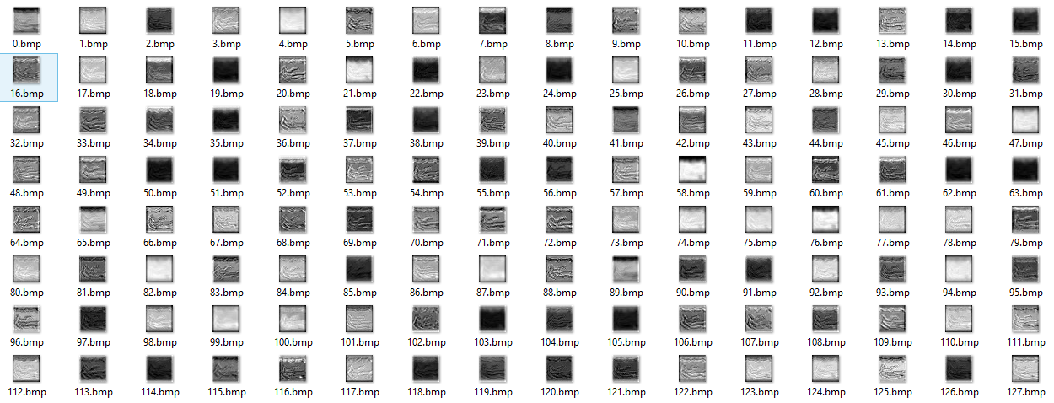
Multi Mask Learned

Slide 15
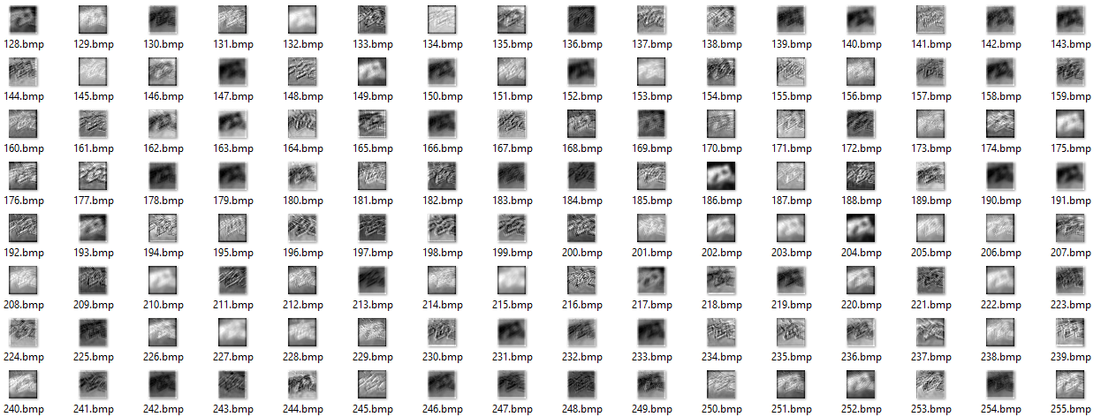
Multi Mask Learned

Slide 16
observation
When filter num increase, accuracy decrease on as-caffe-net, while increase on sal-net
sal-net with 4 saliency plus pure white > 4 saliency > 4 saliency plus pure white and black > pure white > 1saliency plus pure white
accuracy improves quite a lot when using sigmoid on multi mask

Slide 17
Next
Activation Sparse
In map : dose sigmoid .etc help? relu?
Cross map :
more Saliency
How saliency works?

